Slide 1

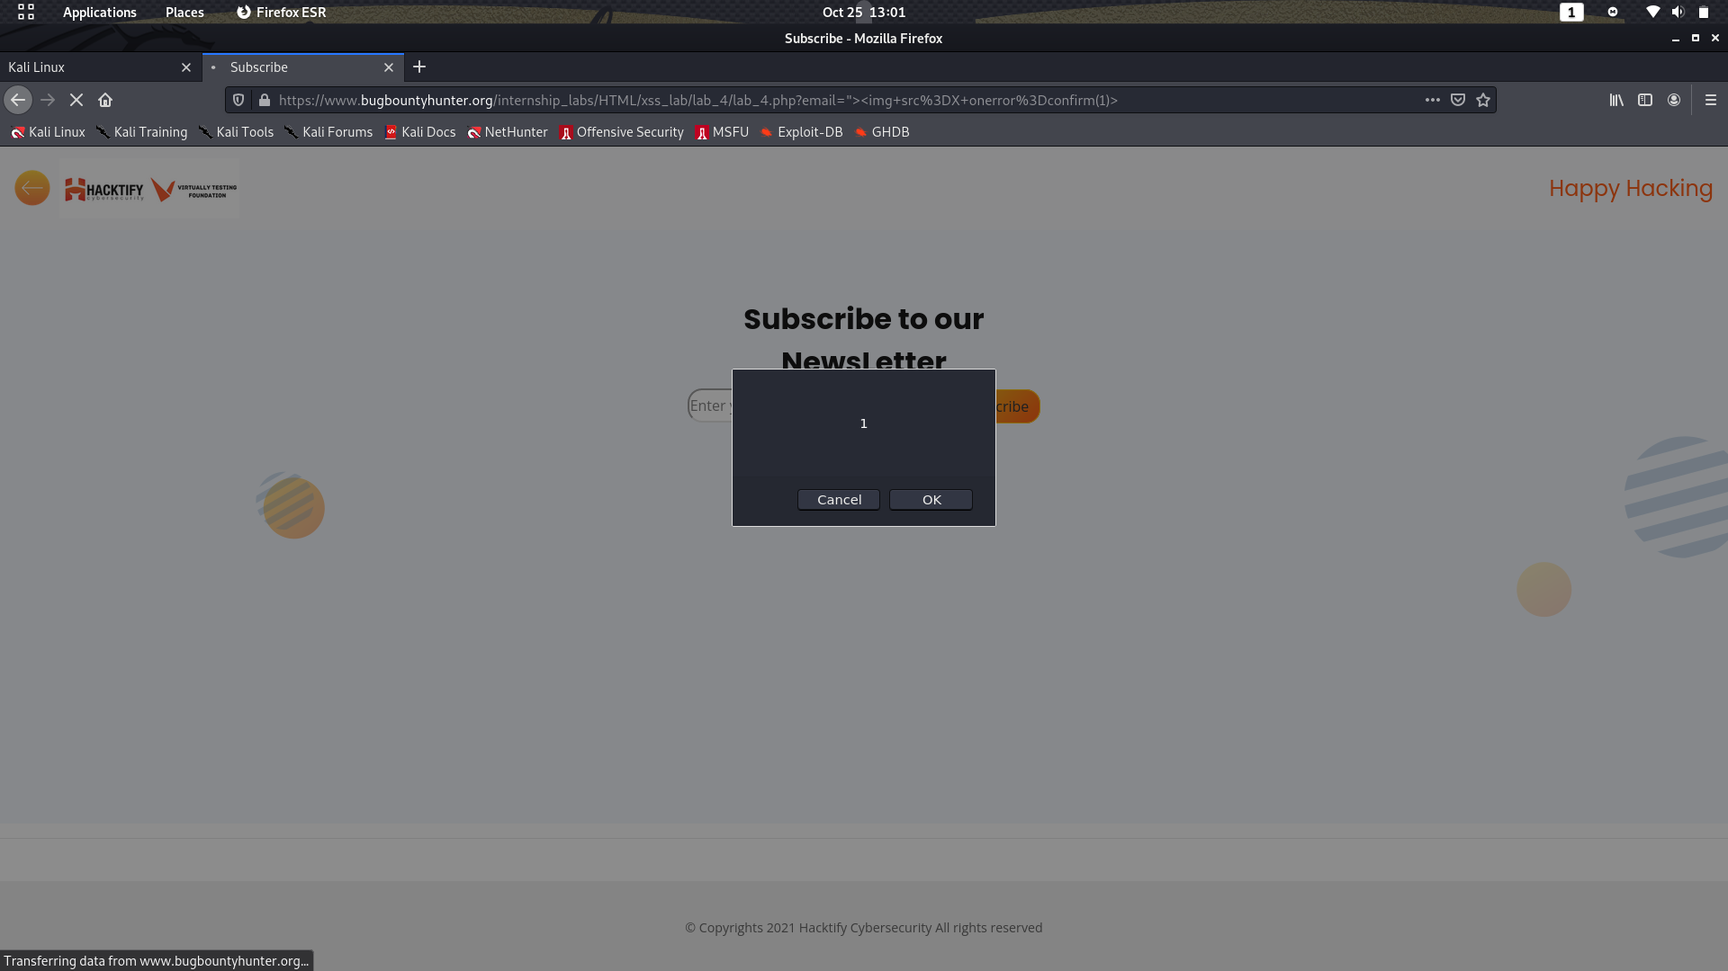
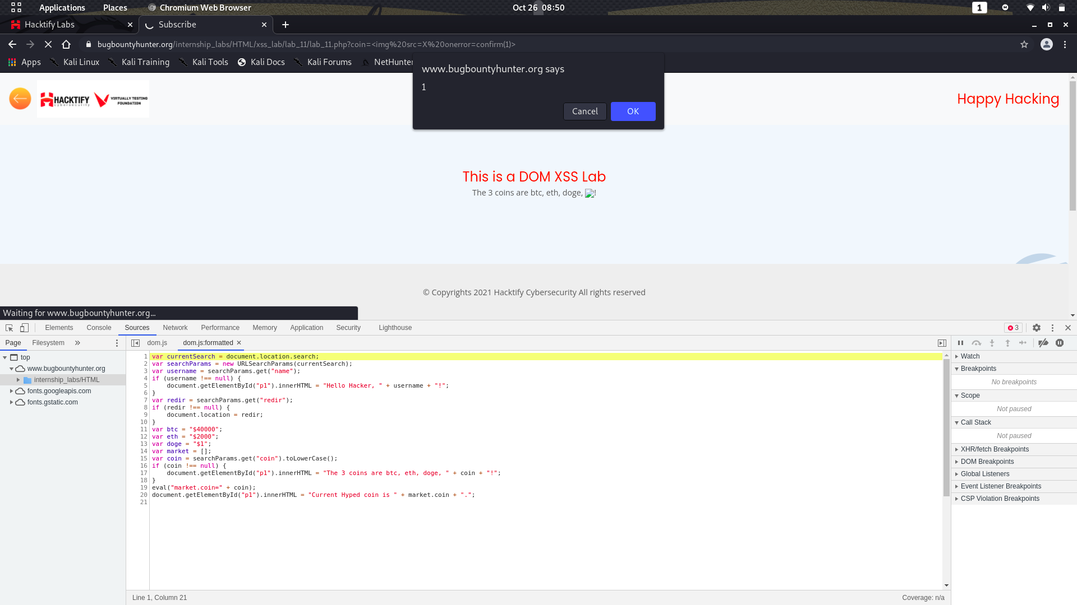
This week I learned about
Virtually Testing Foundation
Stored XSS With Lab Practise
Reflected With Lab Practise
DOM Based With Lab Practise
Networking Skill
Web source analysing

